Slide 1
Naïve Bayes Classifier
Prof. Dr. Faisal Shafait
Professor
School of Electrical Engineering and Computer Science (SEECS)
National University of Sciences and Technology (NUST), Islamabad

Slide 2
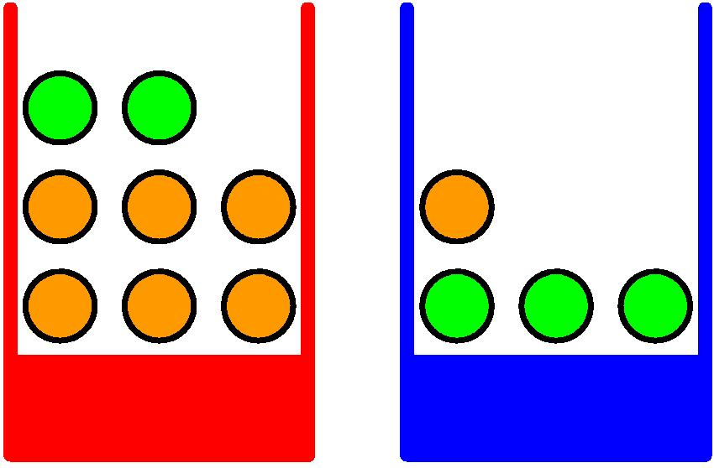
Probability Theory
Apples and Oranges

Slide 3
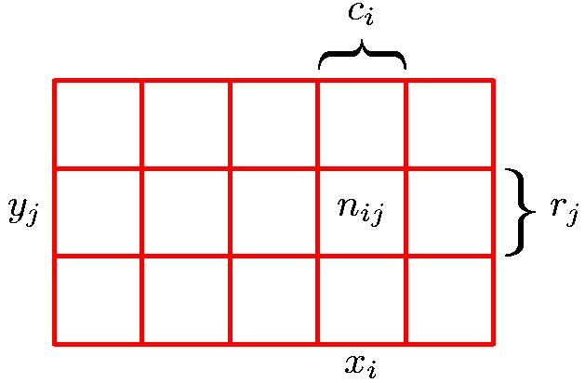
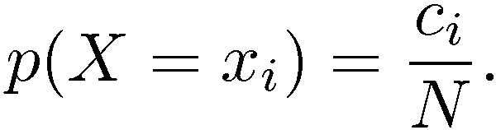
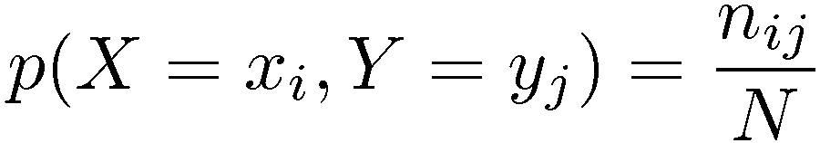
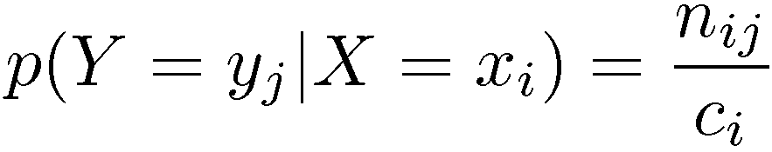
Probability Theory
Marginal Probability
Conditional Probability
Joint Probability

Slide 4
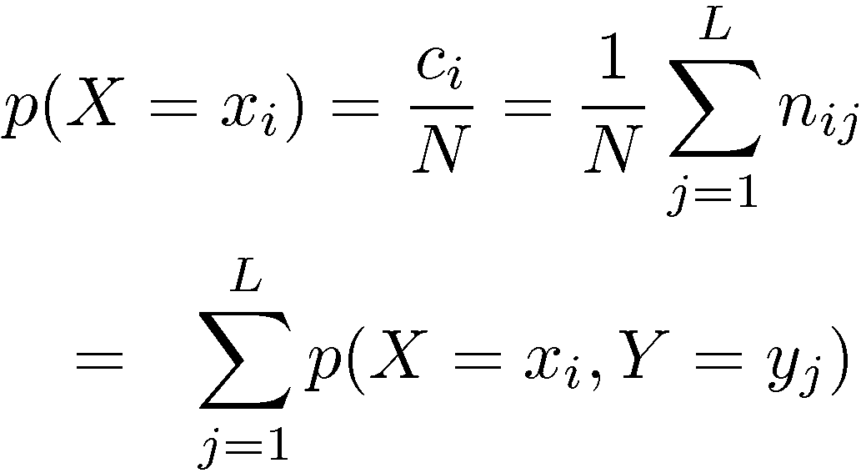
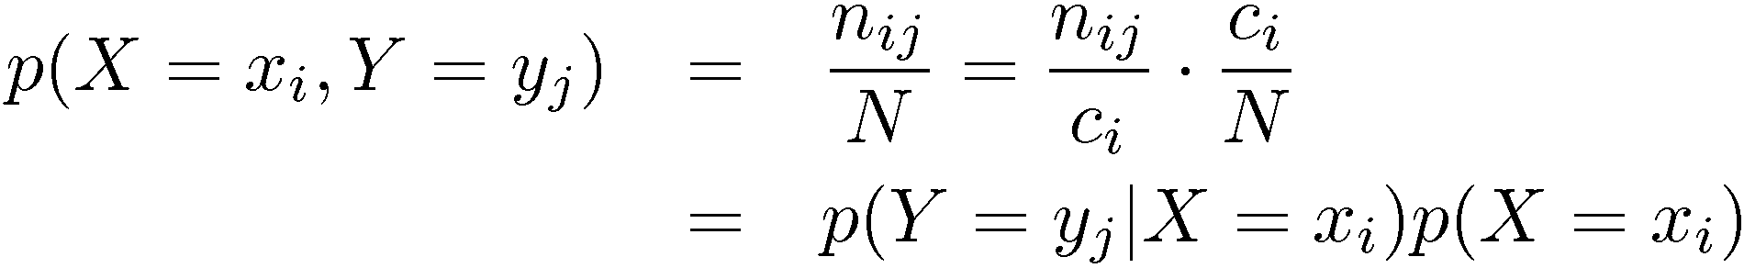
Probability Theory
Sum Rule
Product Rule

Slide 5
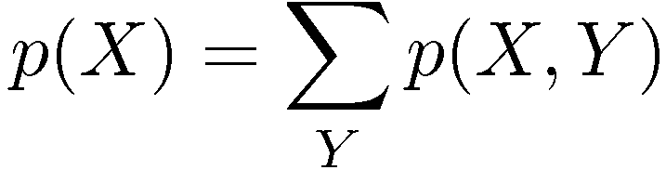

The Rules of Probability
Sum Rule
Product Rule

Slide 6

Quiz

Slide 7
Question
On a true-false test, each question has exactly one correct answer: true, or false. A student knows the correct answer to 70% of the questions on the test. Each of the remaining answers she guesses at random, independently of all other answers. After the test has been graded, one of the questions is picked at random. Given that she got the answer right, what is the chance that she knew the answer?

Slide 8
Definition of a Random Experiment
A random experiment comprises of:
A procedure
An outcome
Procedure
(e.g., flipping a coin)
Sample Space
(Set of All Possible
Outcomes)
Outcome
(e.g., the value
observed [head, tail] after
flipping the coin)

Slide 9
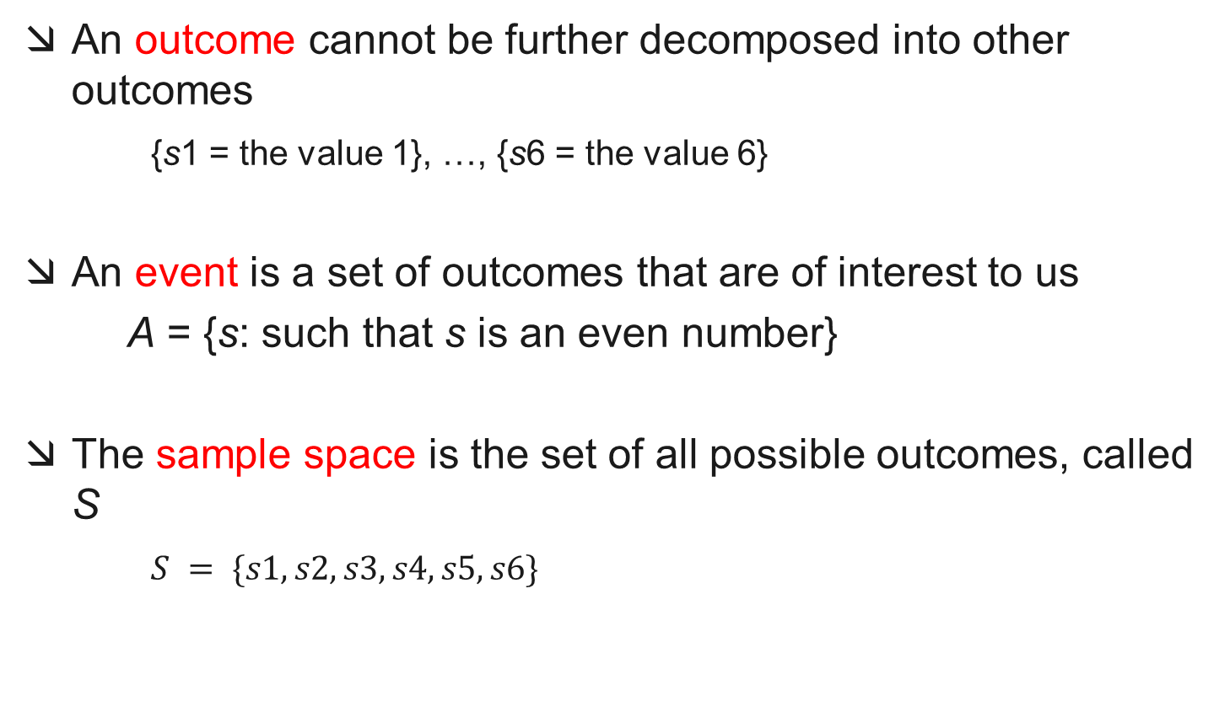
Definition of a Random Experiment: Outcomes, Events and the Sample Space
An outcome cannot be further decomposed into other outcomes
{s1 = the value 1}, …, {s6 = the value 6}
An event is a set of outcomes that are of interest to us
A = {s: such that s is an even number}
The sample space is the set of all possible outcomes, called S
$S = \{s1, s2, s3, s4, s5, s6\}$

Slide 10
Definition of a Random Experiment: Outcomes, Events and the Sample Space
s1
s5
B
s6
s2
s4
A
s3
S

Slide 11
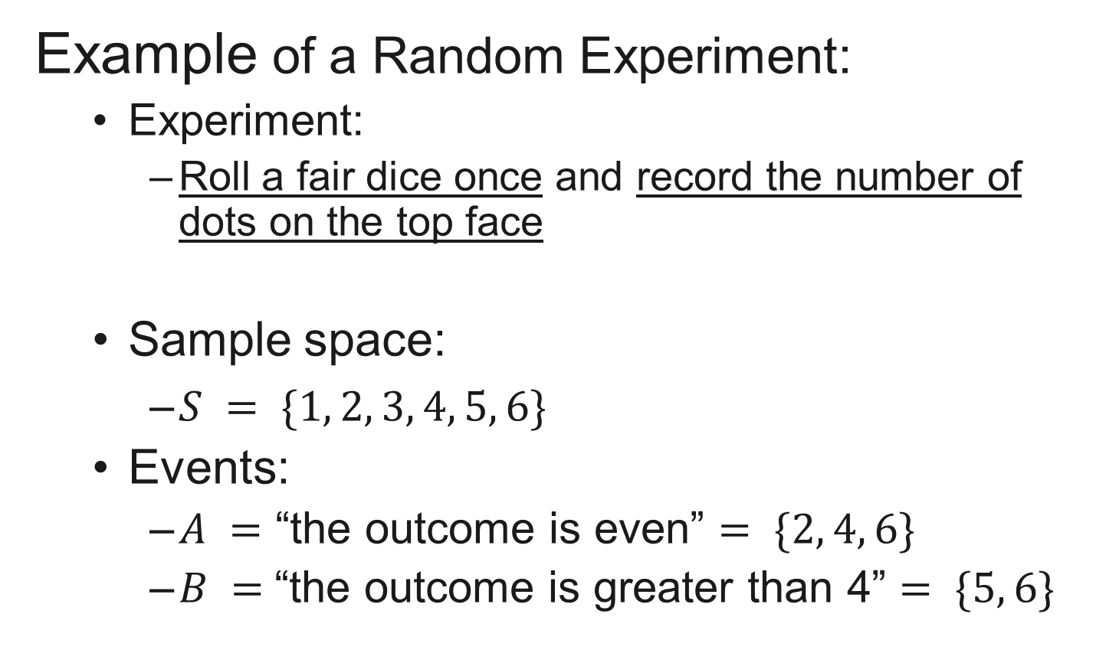
Definition of a Random Experiment: Outcomes, Events and the Sample Space
Example of a Random Experiment:
Experiment:
Roll a fair dice once and record the number of dots on the top face
Sample space:
$S = \{1, 2, 3, 4, 5, 6\}$
Events:
$A =$ “the outcome is even” $= \{2, 4, 6\}$
$B =$“the outcome is greater than 4” $= \{5, 6\}$

Slide 12
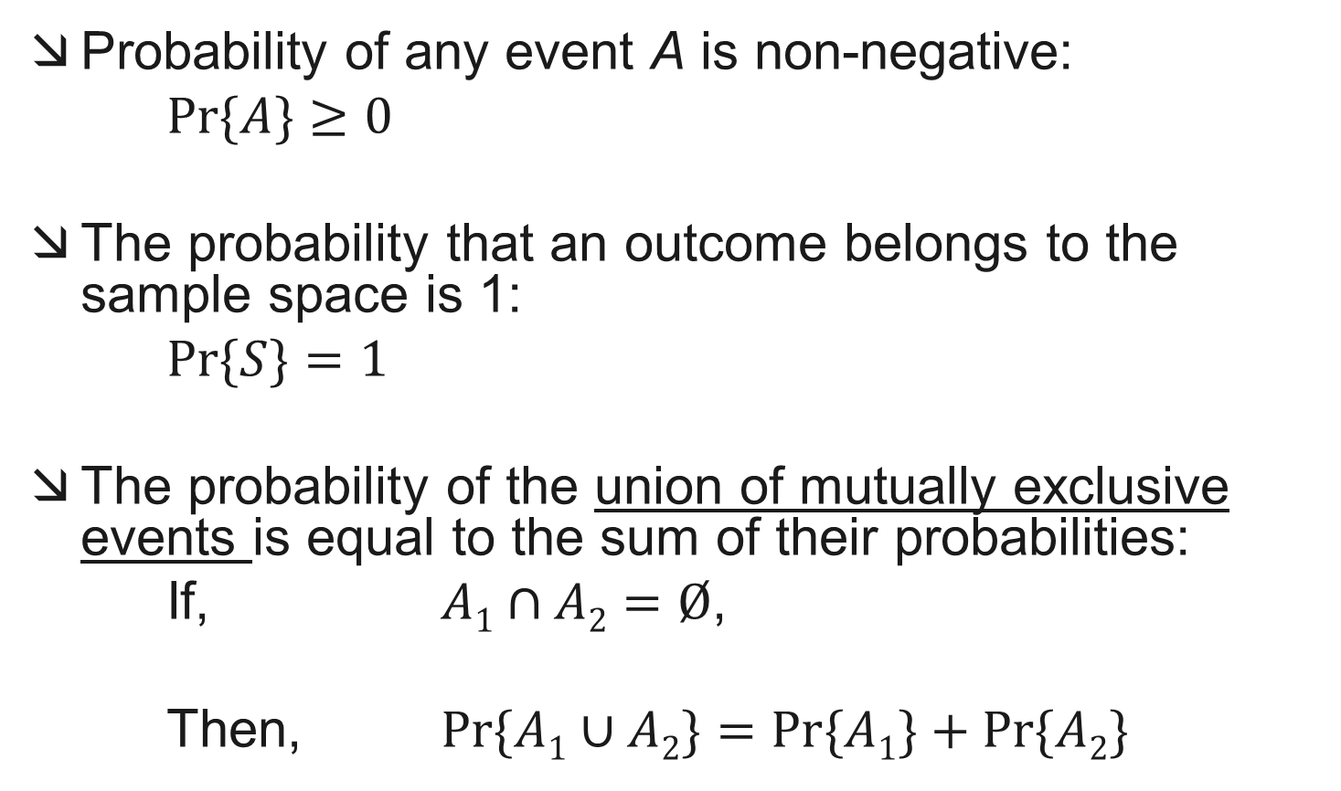
Axioms of Probability
Probability of any event A is non-negative:
$\operatorname{Pr}{⁡\{A\}}≥0$
The probability that an outcome belongs to the sample space is 1:
$Pr⁡\{S\}=1$
The probability of the union of mutually exclusive events is equal to the sum of their probabilities:
If, $A1∩A2=Ø$,
Then, $Pr⁡\{A1∪A2\}=Pr⁡\{A1\}+Pr⁡\{A2\}$

Slide 13
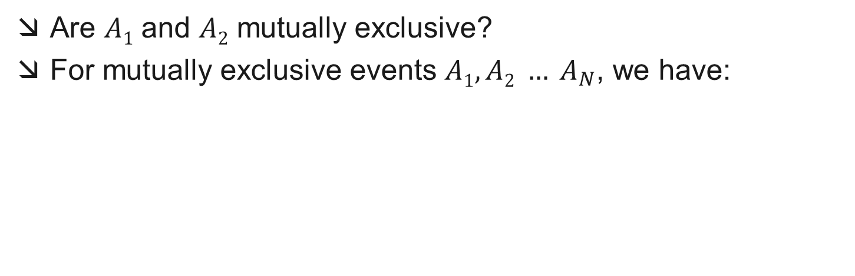
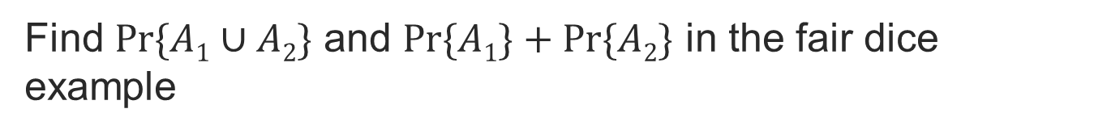
Mutual Exclusivity
Are $A1$ and $A2$ mutually exclusive?
For mutually exclusive events $A1, A2 … A_{N}$, we have:
A₁
s5
s1
s6
s2
s4
A₂
s3
S
Find $Pr⁡\{A1∪A2\}$ and $Pr⁡\{A1\}+Pr⁡\{A2\}$ in the fair dice example

Slide 14

Mutual Exclusivity
Discarding the condition of exclusivity, in general, we have:
$Pr⁡\{A1∪A2\}=??$
s1
s5
A₁
s6
A₂
s4
s2
s3
S

Slide 15

Mutual Exclusivity
Discarding the condition of exclusivity, in general, we have:
$Pr⁡\{A1∪A2\}=Pr⁡\{A1\}+Pr⁡\{A2\}–Pr⁡\{A1∩A2\}$
s1
s5
A₁
s6
A₂
s4
s2
s3
S

Slide 16
Conditional Probability
Given that event B has already occurred, what is the probability that event A will occur?
Given that event B has already occurred, reduces the sample space of A
s1
s5
s1
s5
B
Event B has already occurred
=> s2, s4, s3 cannot occur
B
s6
s6
A
s4
A
s4
s2
s2
S
s3
S
s3

Slide 17
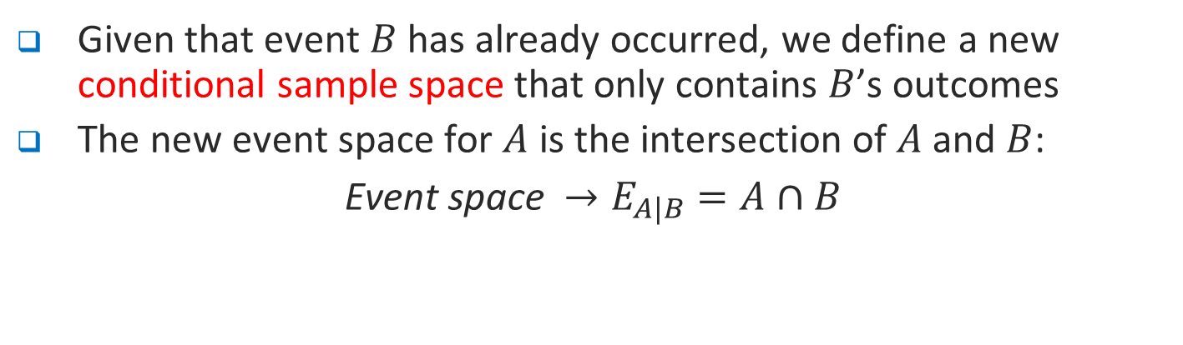


Given that event $B$ has already occurred, we define a new conditional sample space that only contains $B$’s outcomes
The new event space for $A$ is the intersection of $A$ and $B$:
Event space $→E_{A|B}=A∩B$
s1
s5
s1
s5
B
B
Event B has already occurred
s6
s6
A
s4
A
s4
s2
s2
S
s3
S
s3
$$S_{B}=\{s_{1}, s_{5},s_{6},\}$$
What’s missing here?
$$E_{A|B}=A∩B=\{s_{6}\}$$

Slide 18
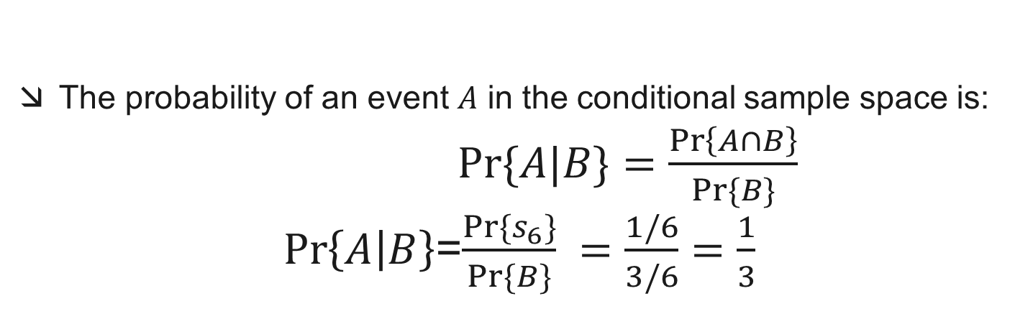

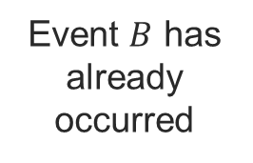
Conditional Probability
The probability of an event $A$ in the conditional sample space is:
$Pr⁡\{A|B\}=\frac{\operatorname{Pr}\left\{A∩B\right\}}{Pr⁡\{B\}}$
$\operatorname{Pr}\left\{A | B\right\}$=$\frac{Pr⁡\{s_{6}\}}{Pr⁡\{B\}} =\frac{1/6}{3/6}=\frac{1}{3}$
s1
s5
s1
s5
B
B
Event $B$ has already occurred
s6
s6
A
s4
A
s4
s2
s2
S
s3
S
s3
$$S_{B}=\{s1, s5, s6\}$$

Slide 19
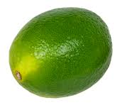




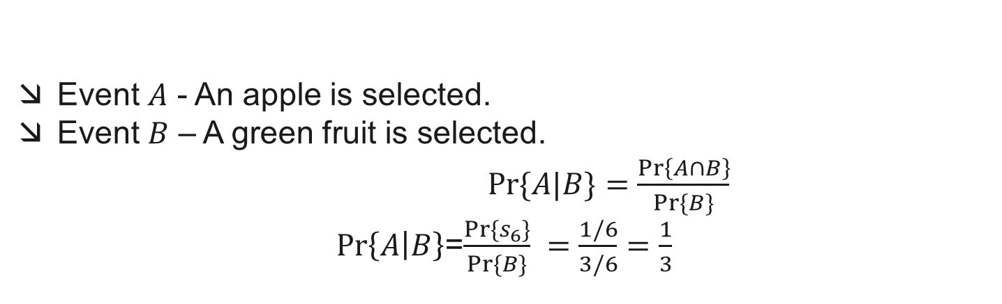

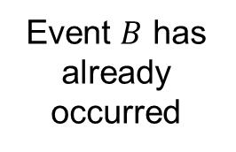
Conditional Probability (Fruit Basket)
Event $A$ - An apple is selected.
Event $B$ – A green fruit is selected.
$Pr⁡\{A|B\}=\frac{\operatorname{Pr}\left\{A∩B\right\}}{Pr⁡\{B\}}$
$\operatorname{Pr}\left\{A | B\right\}$=$\frac{Pr⁡\{s_{6}\}}{Pr⁡\{B\}} =\frac{1/6}{3/6}=\frac{1}{3}$
B
B
Event $B$ has already occurred
A
A
s4
s2
S
S
s3
$$S_{B}=\{pear, lime,apple\}$$

Slide 20
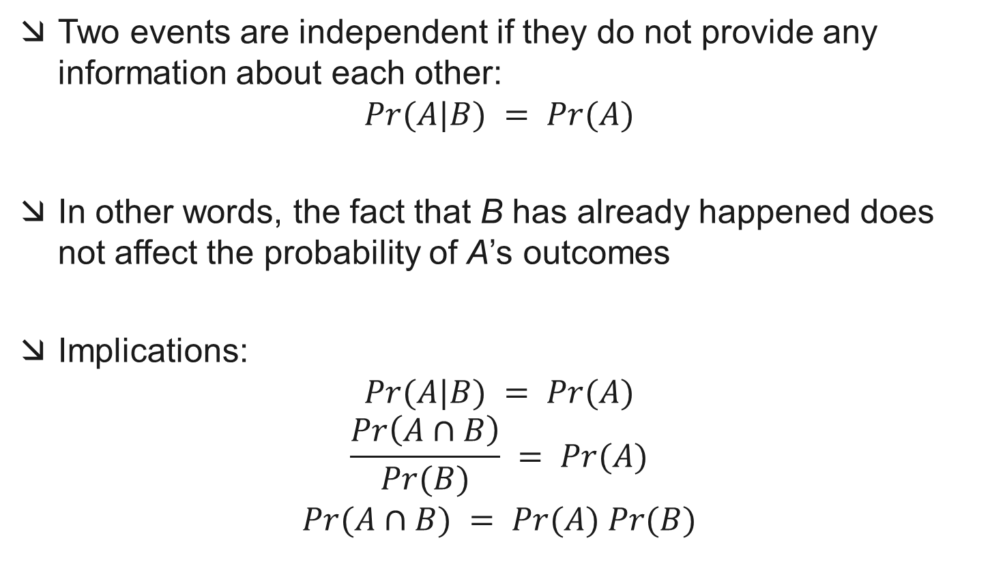
Independence
Two events are independent if they do not provide any information about each other:
$$Pr(A|B) = Pr(A)$$
In other words, the fact that B has already happened does not affect the probability of A’s outcomes
Implications:
$$Pr(A|B) = Pr(A)$$
$$\frac{Pr\left(A∩B\right)}{Pr(B)} = Pr(A)$$
$$Pr(A∩B) = Pr(A) Pr(B)$$

Slide 21

Independence: Example
Are events $A$ and $C$ independent?
Assume that all outcomes are equally likely
s2
C
s6
s4
B
s5
s1
s3
A
S

Slide 22

Independence: Example
Are events $A$ and $C$ independent?
Check if $Pr(A∩C) = Pr(A) Pr(C)$
s2
C
s6
s4
B
s5
s1
s3
A
S

Slide 23

Independence: Example
Are events A and C independent?
$$Pr⁡\{A∩C\}=Pr⁡\{s5\} =\frac{1}{6}$$
$$\operatorname{Pr}\left\{A\right\}\operatorname{Pr}\left\{C\right\}=\frac{3}{6}⨯\frac{2}{6} =\frac{1}{6}$$
Yes!
s2
C
s6
s4
B
s5
s1
s3
A
S

Slide 24
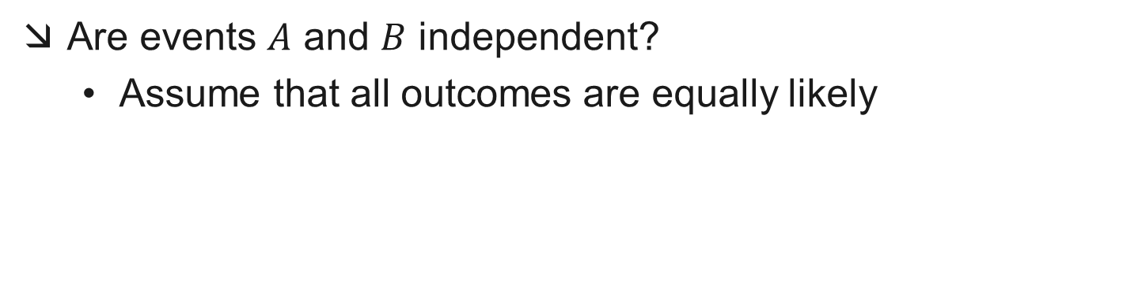
Independence: Example
Are events $A$ and $B$ independent?
Assume that all outcomes are equally likely
s2
C
s6
s4
B
s5
s1
s3
A
S

Slide 25
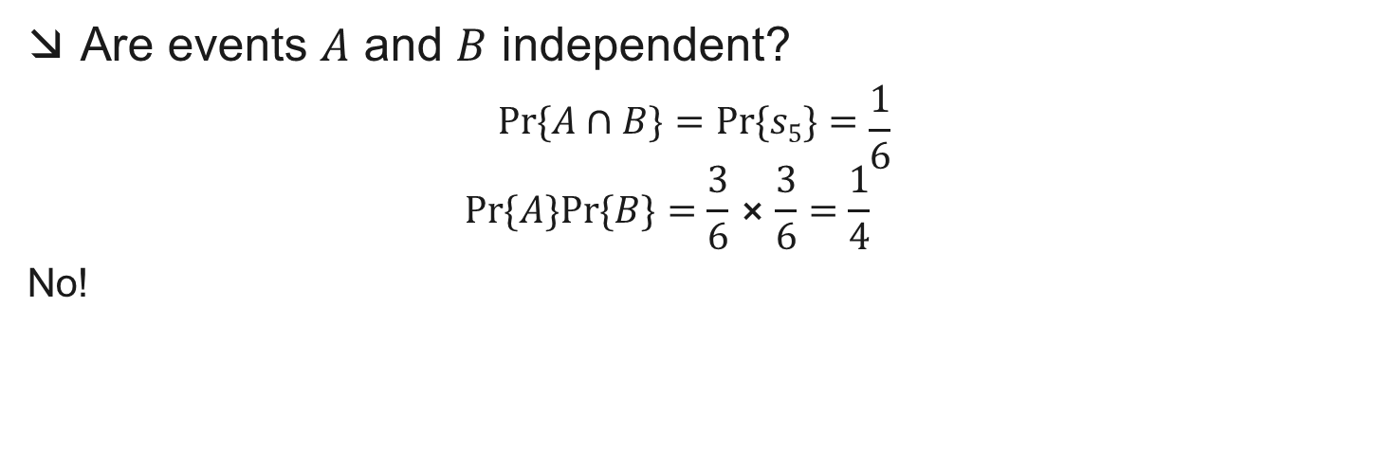
Independence: Example
Are events $A$ and $B$ independent?
$$Pr⁡\{A∩B\}=Pr⁡\{s5\}=\frac{1}{6}$$
$$Pr⁡\{A\}Pr⁡\{B\}=\frac{3}{6}⨯\frac{3}{6}=\frac{1}{4}$$
No!
s2
C
s6
s4
B
s5
s1
s3
A
S

Slide 26

Definition of a Random Variable
A random variable is a mapping from an outcome s of a random experiment to a real number
$$X:S→S_{X}⊂ℝ$$
domain
range
S_{X} is called the image of X

Slide 27

Definition of a Random Variable
$$X:S→S_{X}⊂ℝ$$
Random Experiment
Sample Space
X(s)
Random Variable
head
0
1
R
tail
S_{x}

Slide 28


Definition of a Random Variable
$$X:S→S_{X}⊂ℝ$$
X(s)
1
2
3
4
5
6
R
Random Experiment
Sample Space, S
S_{x}
Random Variable
Image courtesy of www.buzzle.com/

Slide 29
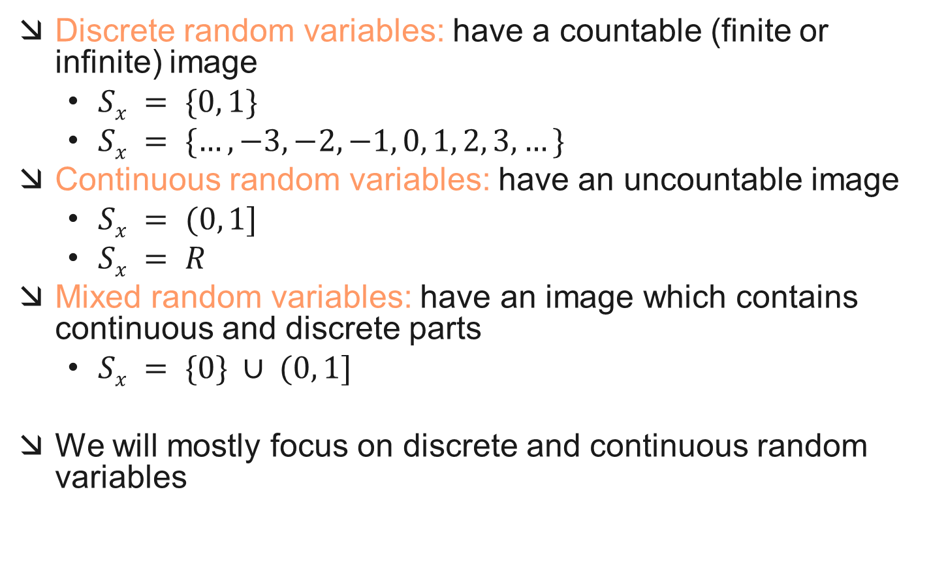
Types of Random Variables
Discrete random variables: have a countable (finite or infinite) image
$Sx = \{0, 1\}$
$Sx = \{…, −3, −2, −1, 0, 1, 2, 3, …\}$
Continuous random variables: have an uncountable image
$Sx = (0, 1]$
$Sx = R$
Mixed random variables: have an image which contains continuous and discrete parts
$Sx = \{0\} ∪ (0, 1]$
We will mostly focus on discrete and continuous random variables

Slide 30




Probability Mass Function
The Probability Mass Function (PMF) or the discrete probability density function provides the probability of a particular point in the sample space of a discrete random variable (RV)
For a countable $SX=\{a0, a2, …, a_{n}\}$, the PMF is the set of probabilities
$$pX(ak)$$
$$SX=\{a0=0, a1=1, …, a5=5\},$$
0
1
2
3
4
5
$$X$$

Slide 31
Gaussian Distributions

Slide 32
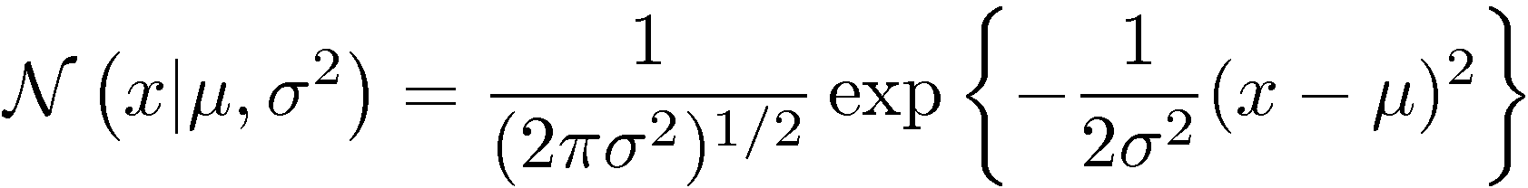
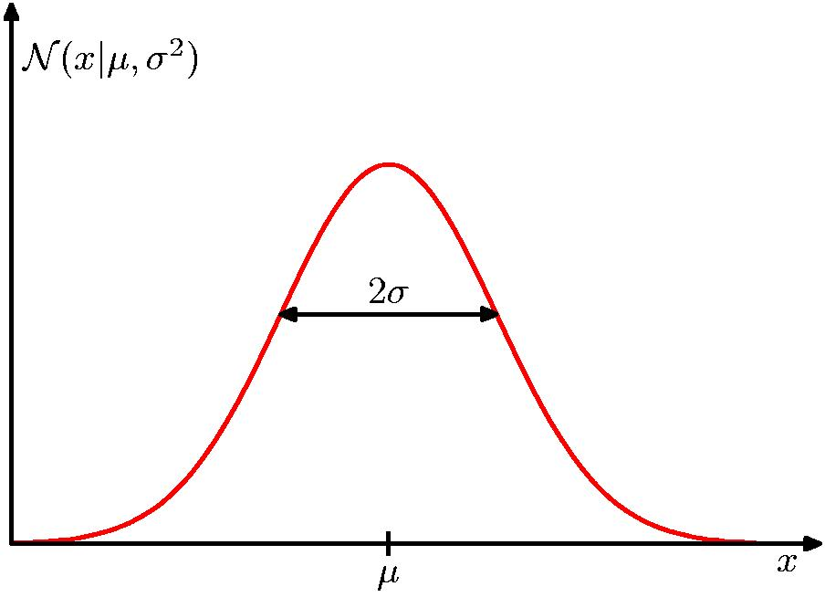
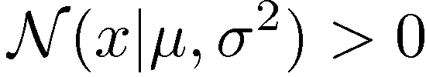
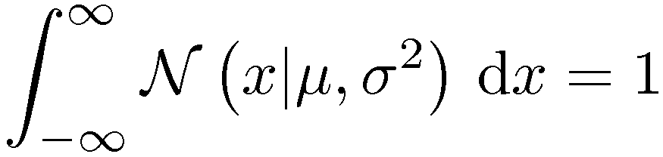
The Gaussian Distribution

Slide 33
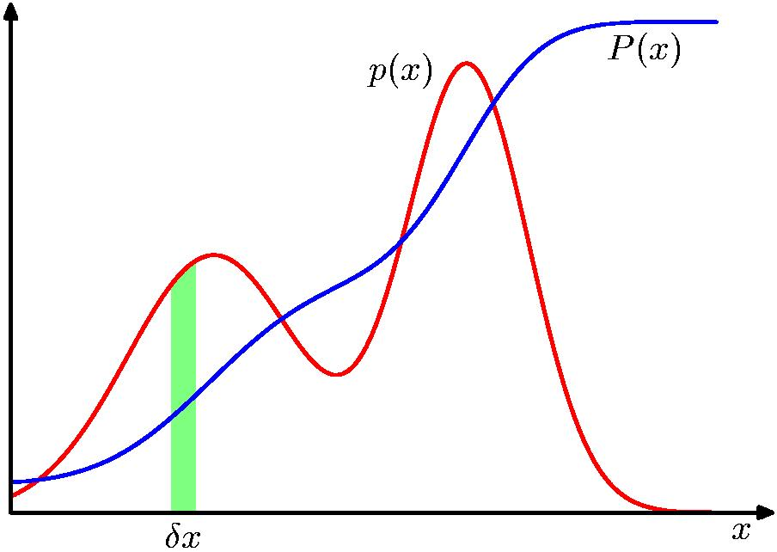
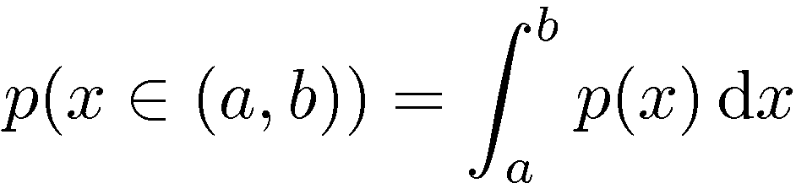
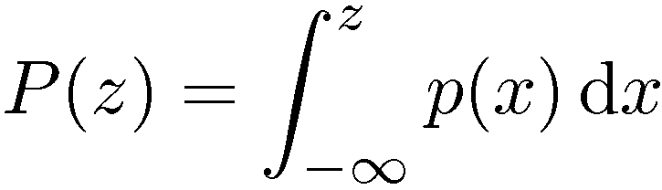
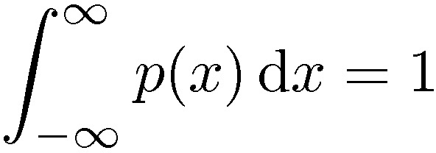

Probability Densities

Slide 34
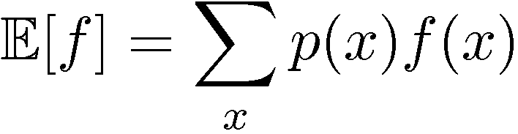
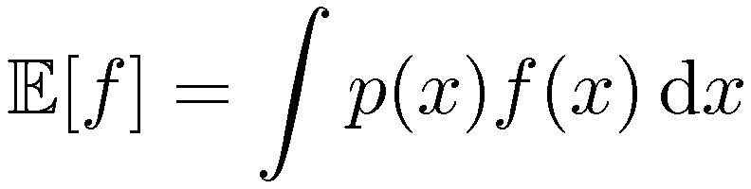
Expectations

Slide 35
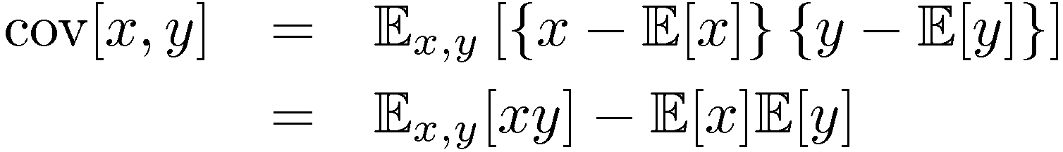
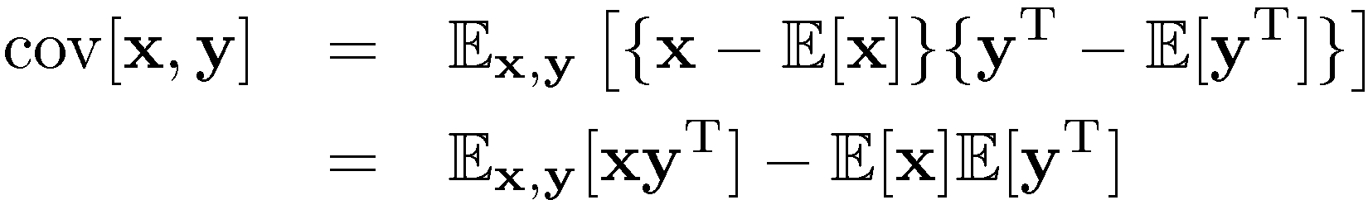
Variances and Covariances

Slide 36
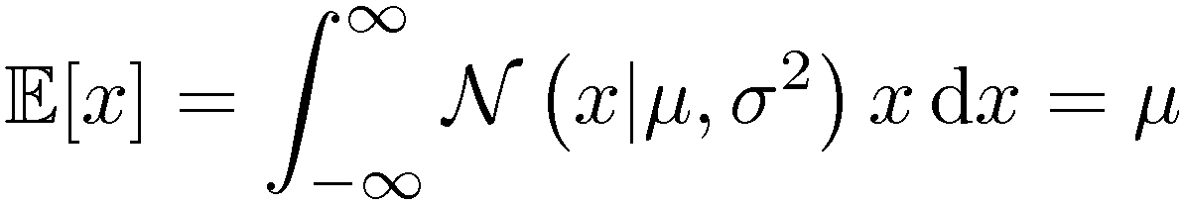
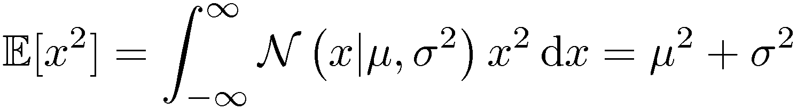
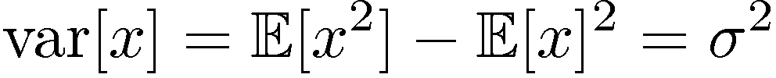
Gaussian Mean and Variance

Slide 37
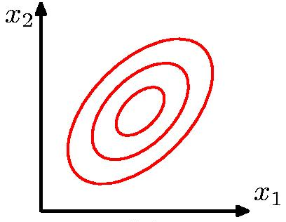
The Multivariate Gaussian

Slide 38
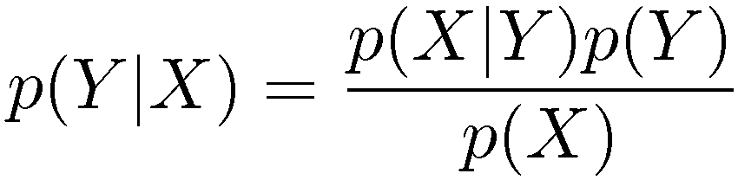
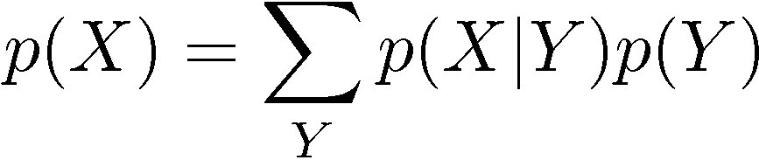
Bayes’ Theorem
posterior ∝ likelihood × prior

Slide 39
Naïve Bayes Classifier

Slide 40


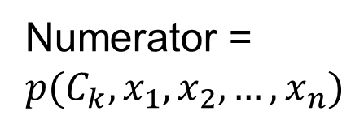
Conditional Independence Assumption
Numerator = $p(C_{k}, x_{1},x_{2},…, x_{n})$

Slide 41
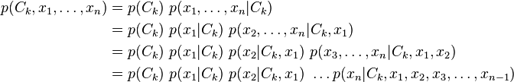
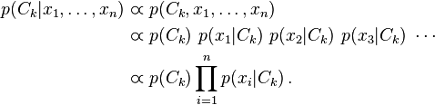

Conditional Independence Assumption

Slide 42
Example
Consider a spam email classifier with two features:
x1: Presence of the word 'cheap'.
x2: Presence of the word 'offer'.

Slide 43
Suppose we have the following training data
Email | Spam(y=1) | Cheap (x1) | Offer (x2)
1 | Yes | Yes | Yes
2 | No | No | Yes
3 | Yes | Yes | No
4 | No | No | No

Slide 44
Example (continued)
From this, we can calculate the probabilities:
P(Spam = Yes) = 2/4 = 0.5
P(Spam = No) = 2/4 = 0.5
P(Cheap = Yes|Spam = Yes) = 2/2 = 1.0
P(Cheap = No|Spam = Yes) = 0/2 = 0.0
P(Cheap = Yes|Spam = No) = 0/2 = 0.0
P(Cheap = No|Spam = No) = 2/2 = 1.0
P(Offer = Yes|Spam = Yes) = 1/2 = 0.5
P(Offer = No|Spam = Yes) = 1/2 = 0.5
P(Offer = Yes|Spam = No) = 1/2 = 0.5
P(Offer = No|Spam = No) = 1/2 = 0.5

Slide 45
Given a new email with features
Cheap = Yes and Offer = Yes:
P(Spam = Yes|Cheap = Yes, Offer = Yes)
= P(Cheap=Yes|Spam=Yes)*P(Offer=Yes|Spam=Yes)*P(Spam=Yes)/ P(Cheap = Yes) * P(Offer = Yes)
= (1.0 * 0.5 * 0.5) / P(Cheap = Yes) * P(Offer = Yes) = 0.25 / Z
P(Spam = No|Cheap = Yes, Offer = Yes)
=(0.0 * 0.5 * 0.5) / P(Cheap = Yes) * P(Offer = Yes) = 0 / Z
Since 0.25 > 0, the classifier would predict the email as spam.

